Slide 1
The Forest of S.T. Shrew

Slide 2
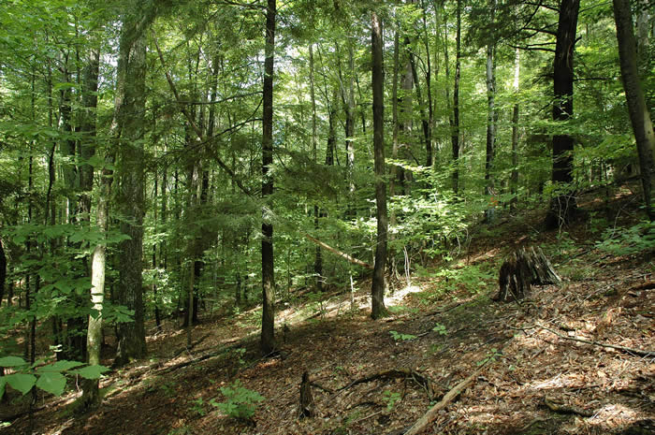

Slide 3
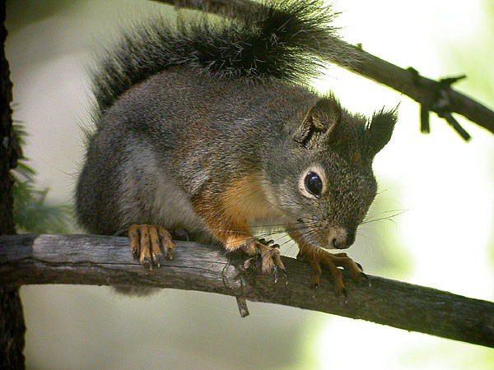
squirrel

Slide 4
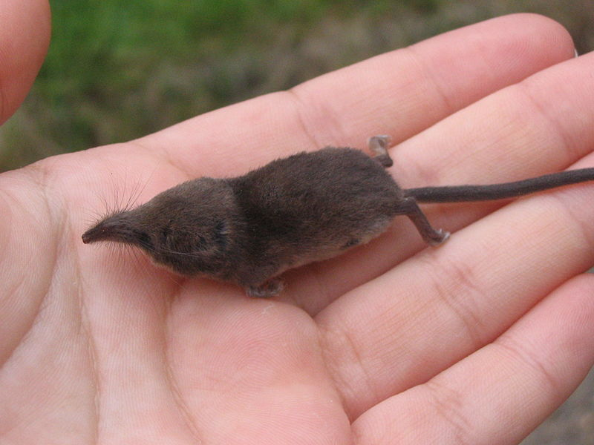
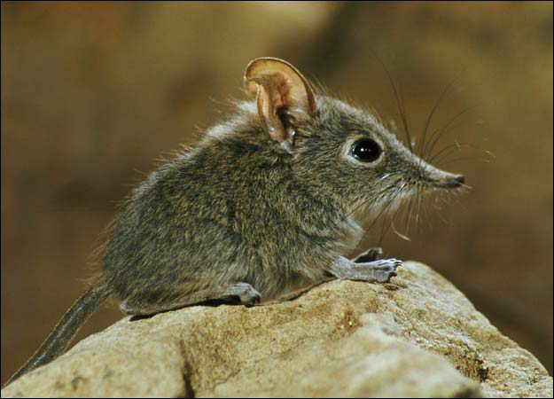
Shrew

Slide 5
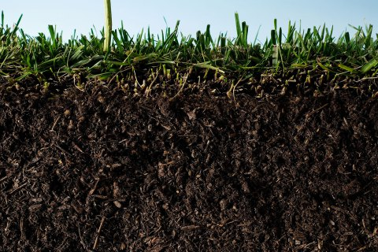
In the Ground

Slide 6
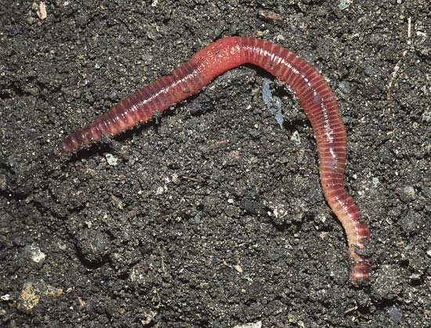
Earth worm

Slide 7
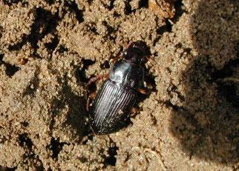
beetles

Slide 8
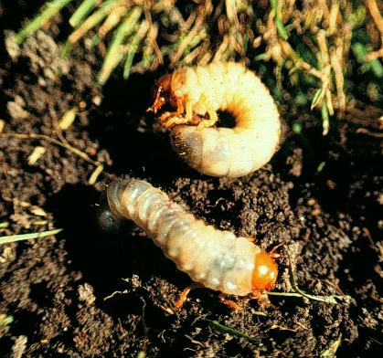
Grub worm

Slide 9
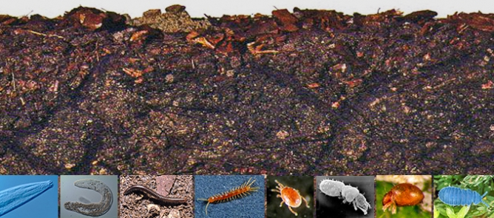
Many other organisms

Slide 10
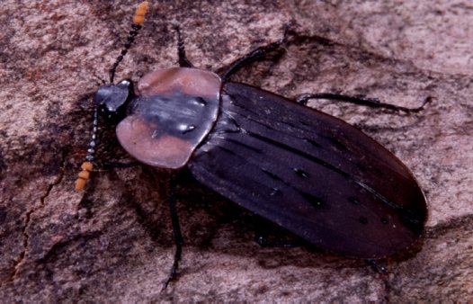
Carrion beetle

Slide 11
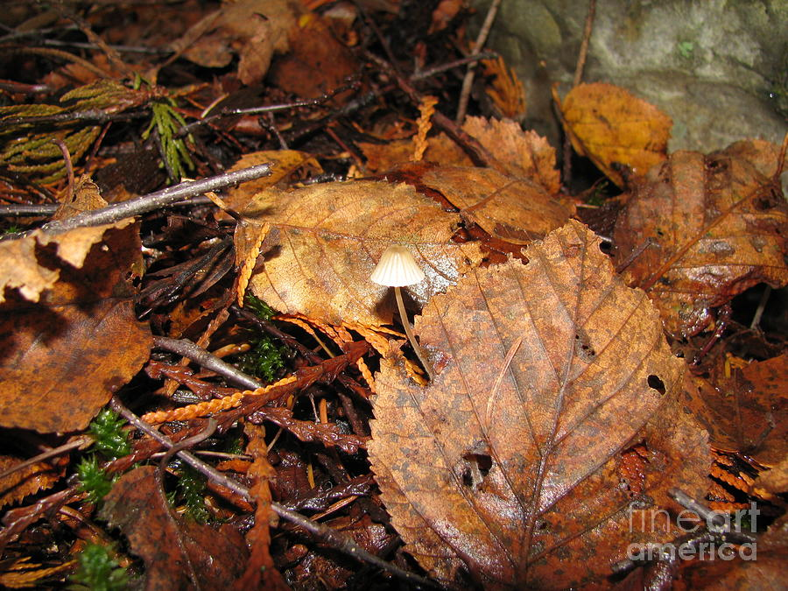
On the surface

Slide 12
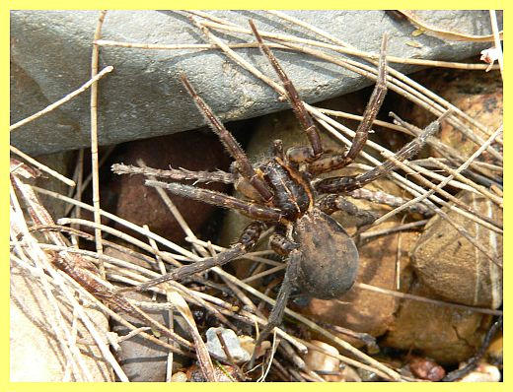
Brown spider

Slide 13
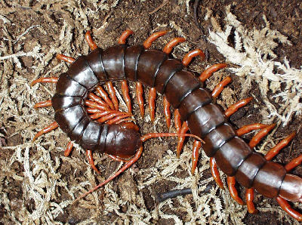
centipede

Slide 14
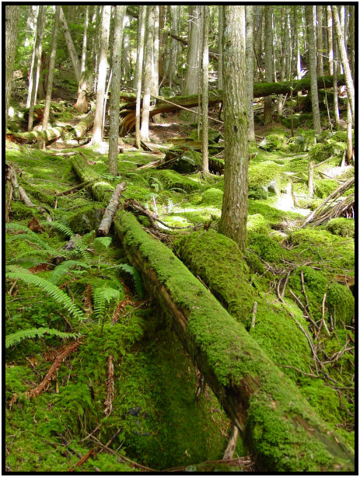
Moss growing on log

Slide 15
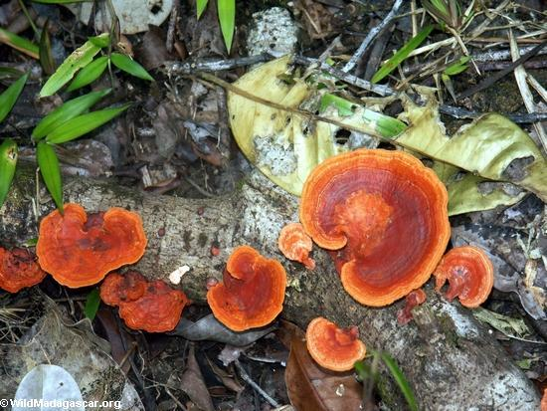
Orange fungi

Slide 16
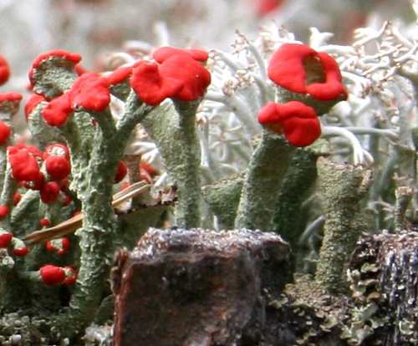
Red capped lichen

Slide 17
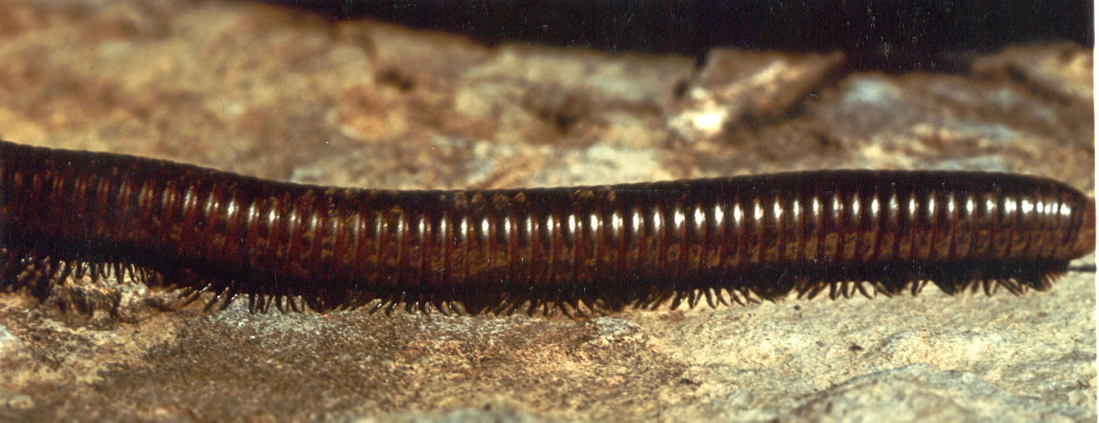
millipede

Slide 18
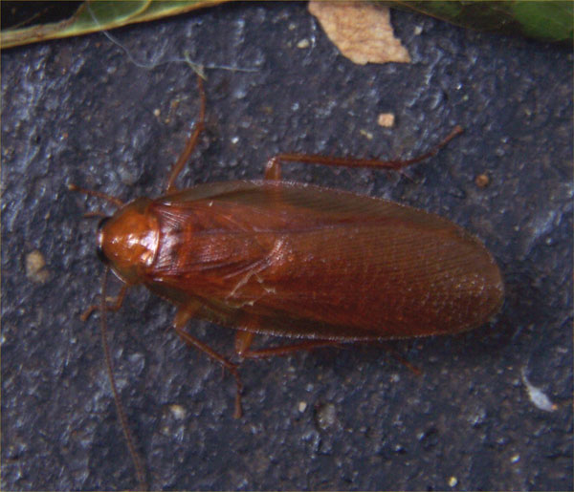
Wood roach

Slide 19
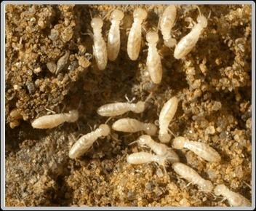
termites

Slide 20
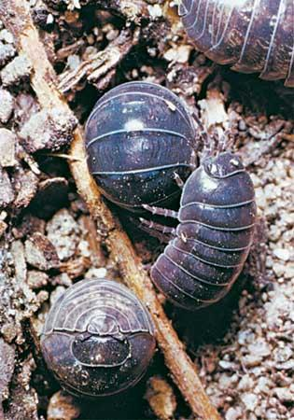
Pill bug

Slide 21
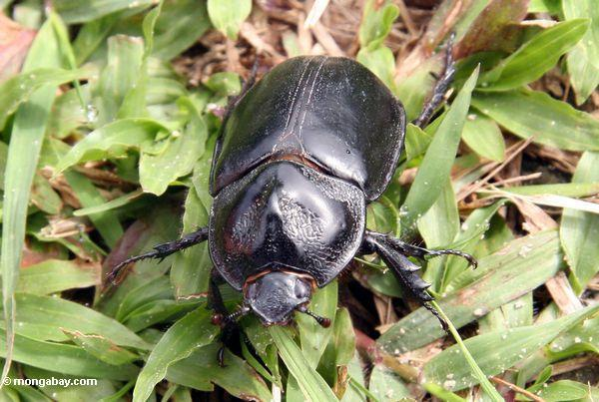
Black Beetle

Slide 22
centipede

Slide 23
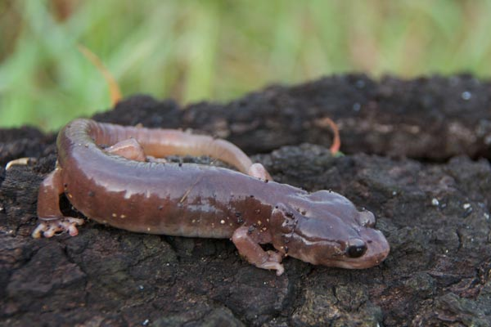
salamander

Slide 24
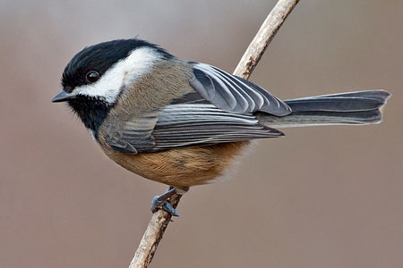
Black capped bird

Slide 25
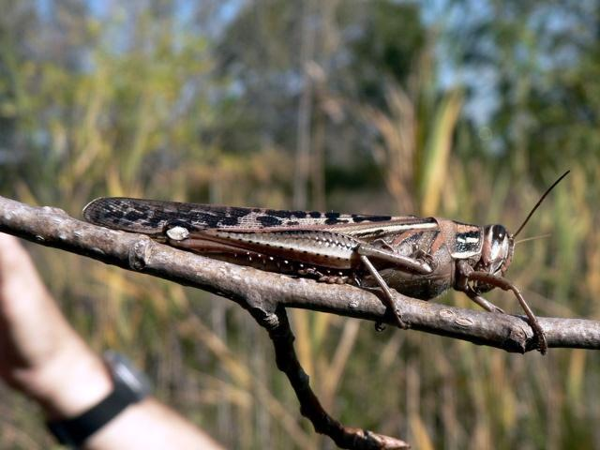
grasshopper

Slide 26
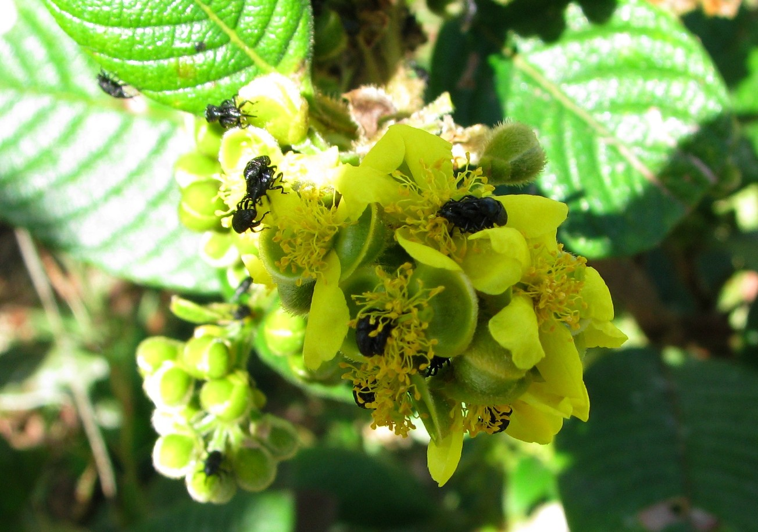
bugs

Slide 27
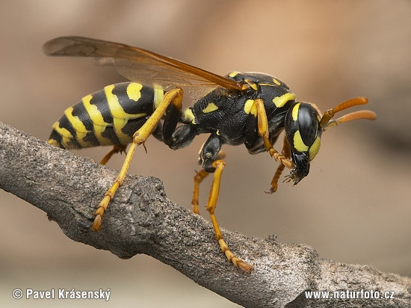
wasp

Slide 28
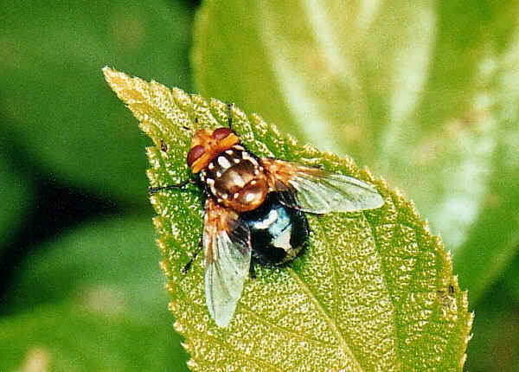
fly

Slide 29
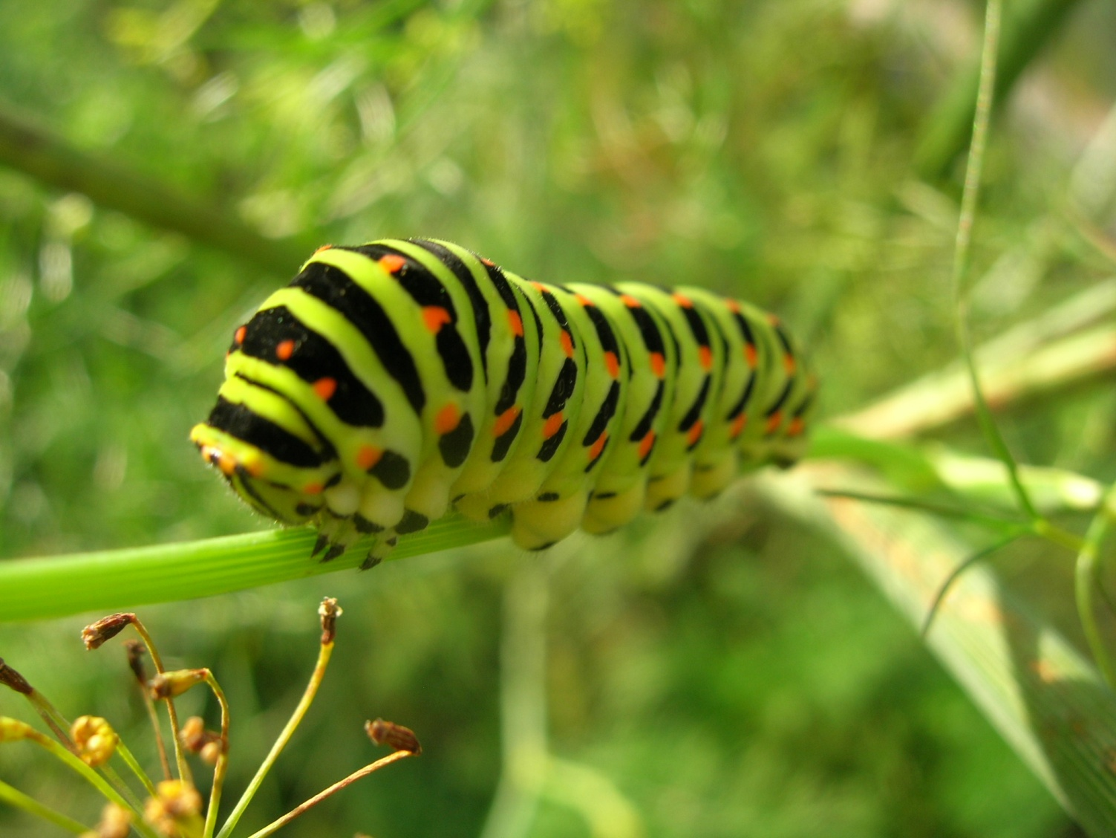
caterpillar

Slide 30
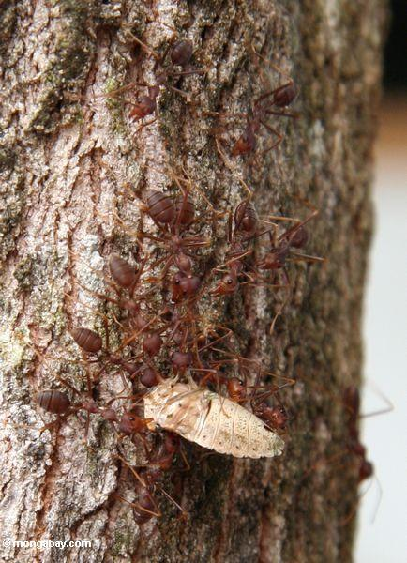
ants

Slide 31
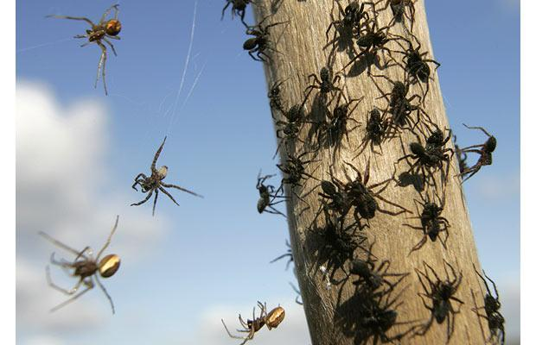
spiders

Slide 32
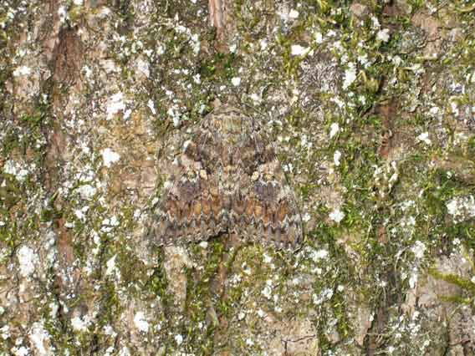
moth

Slide 33
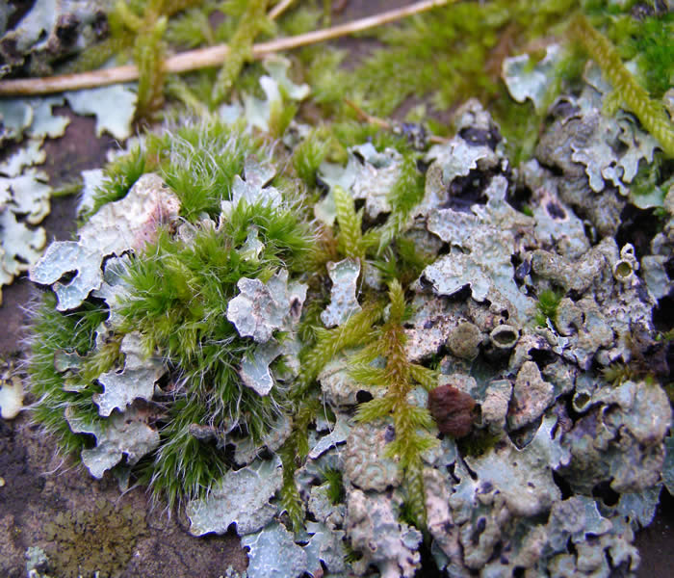
Lichen and moss

Slide 34
In the Ground

Slide 36
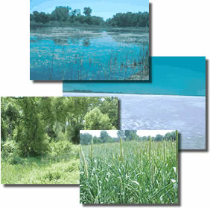
Copy these notes in your journal.
What’s a Habitat?
The place where an organism lives; (habitat = home)
A habitat must include all characteristics that support living things: food, water, shelter.
Examples: pond, ocean, forest, prairie
Notes:
‹#›

Slide 37
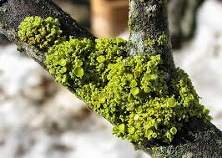
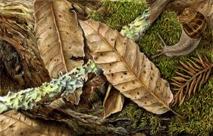
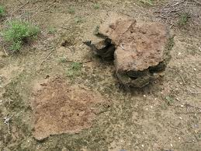
What is a Microhabitat?
A microhabitat is a small habitat within a larger habitat.
-The temperature, humidity, light and soil may be different from the surrounding habitat.
-Examples: under rocks, soil, anthill, underground burrows, rotting log
-Non-examples: Forest, ocean, Desert
Micro = Small
Habitat = Home
Microhabitat = small home
Notes:
‹#›

Slide 38
How do microhabitats support a variety of organisms?
Microhabitats have different abiotic factors: temperature, water, and sunlight
For example: Organisms that are found under rocks might not be found on a tree . (Although they could be) because the abiotic factor are different.

Slide 39
In Your Journal….
Reflect on the story of S.T. Shrew:
List 3 microhabitats visited
List the organisms found there
List the factors present to support them
Microhabitat | Organisms | Supporting abiotic factors

Slide 40
Extend your thinking…
Identify as many microhabitats that you can think of. List the types of organisms you would expect to find there and the supporting abiotic factors.
How could the loss of particular microhabitats effect the larger habitat?

